Slide 1
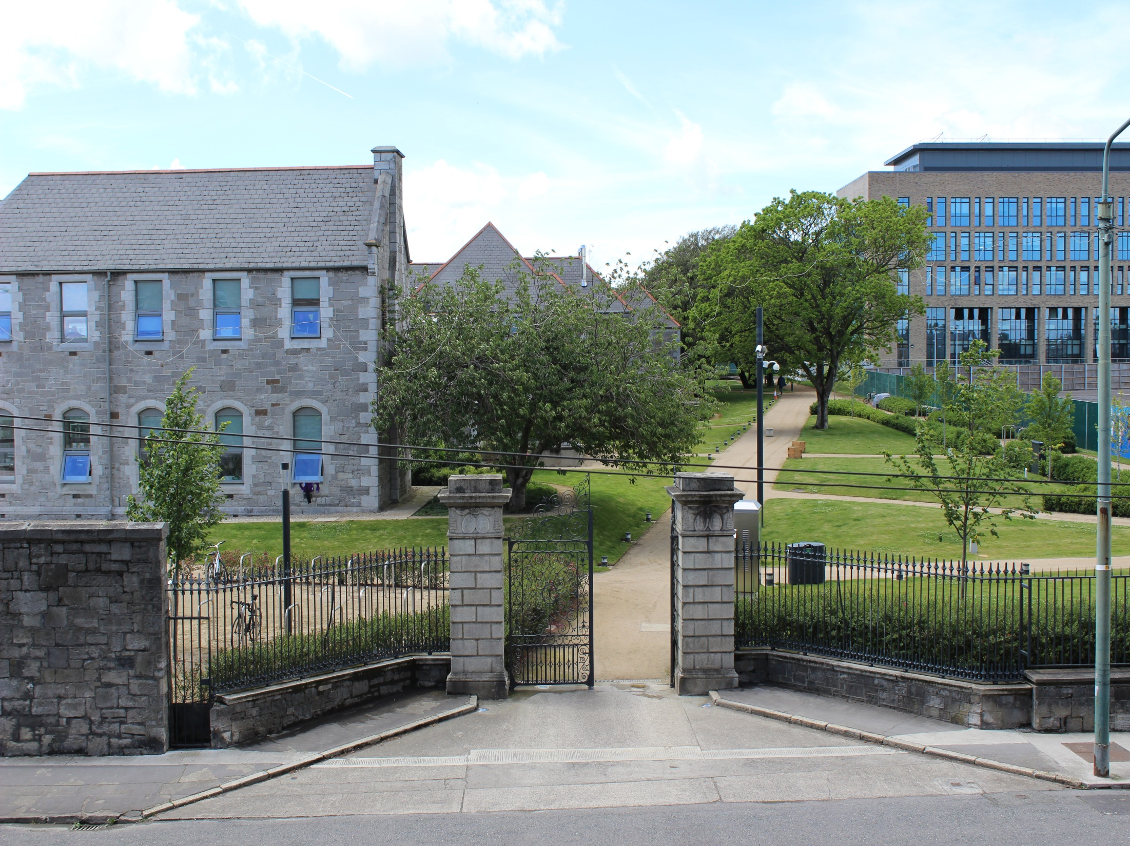
GDA Consultative Group – 21st September, 2017
Ronan Doyle
Grangegorman Development Agency

Slide 2
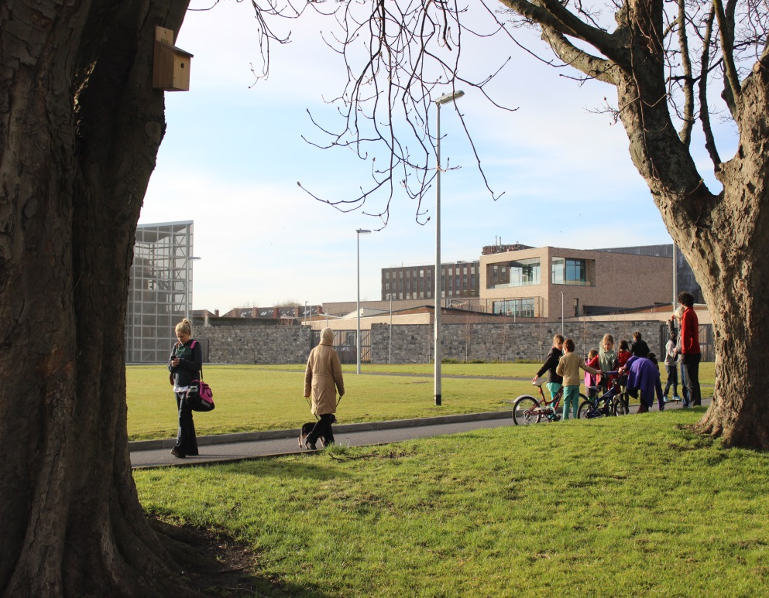
Overview
Update
Health
DIT
Other Projects
Communications
Public Art

Slide 3
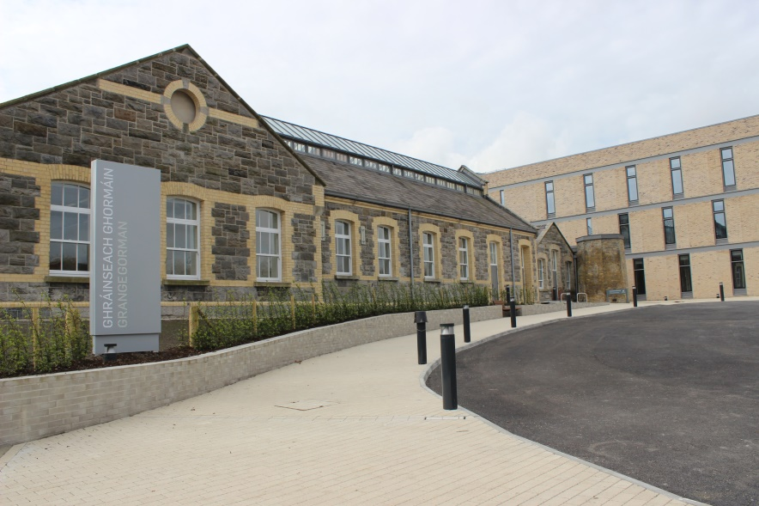
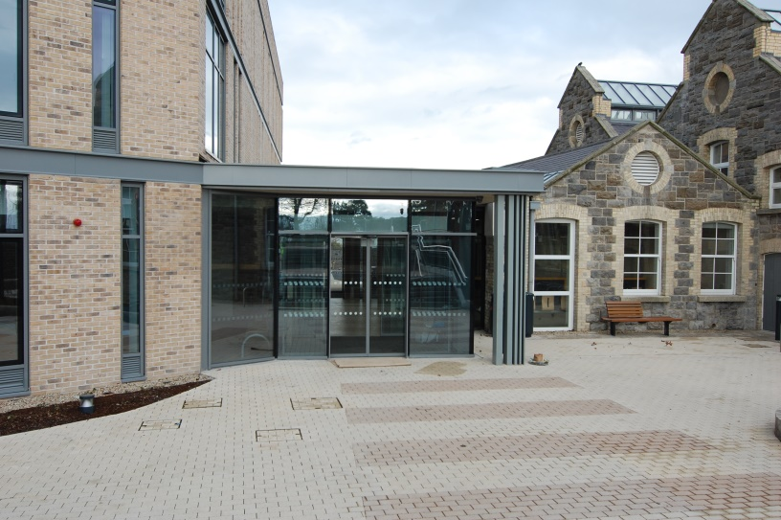
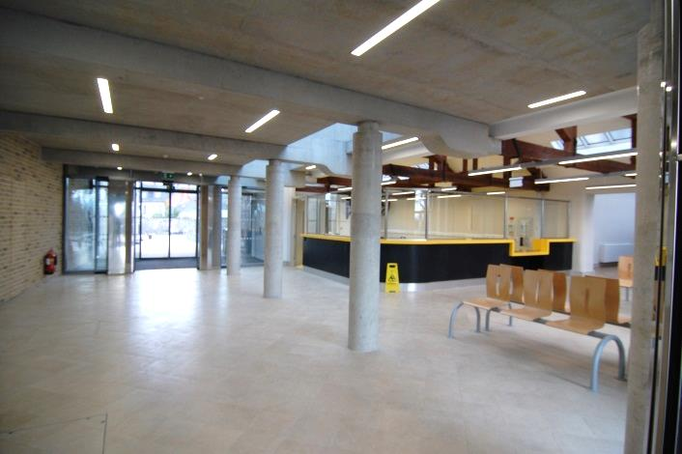
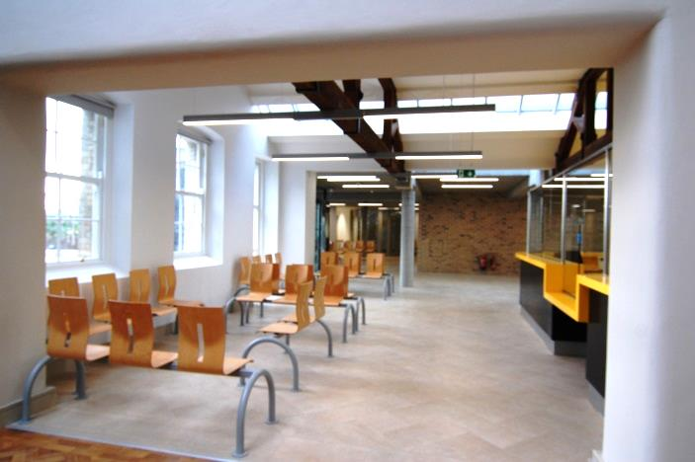
Primary Care Centre

Slide 4
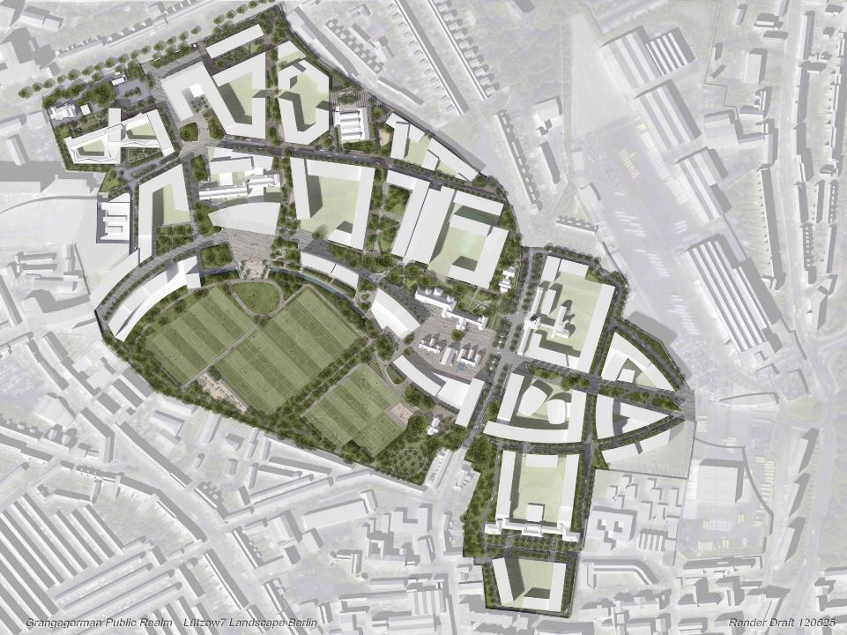
Residential Care neighbourhood
Deadline for Design team
Competition was Wednesday
20th September

Slide 5
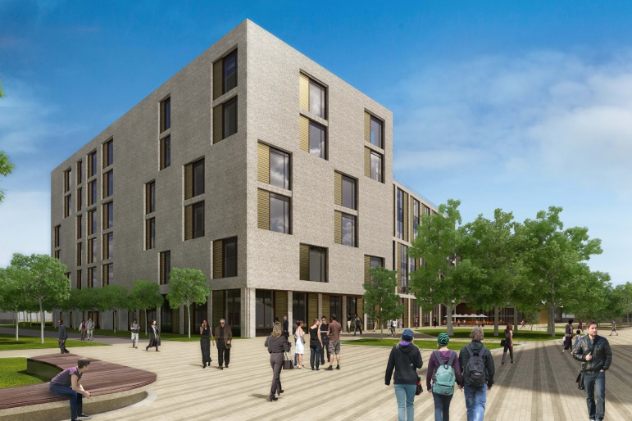
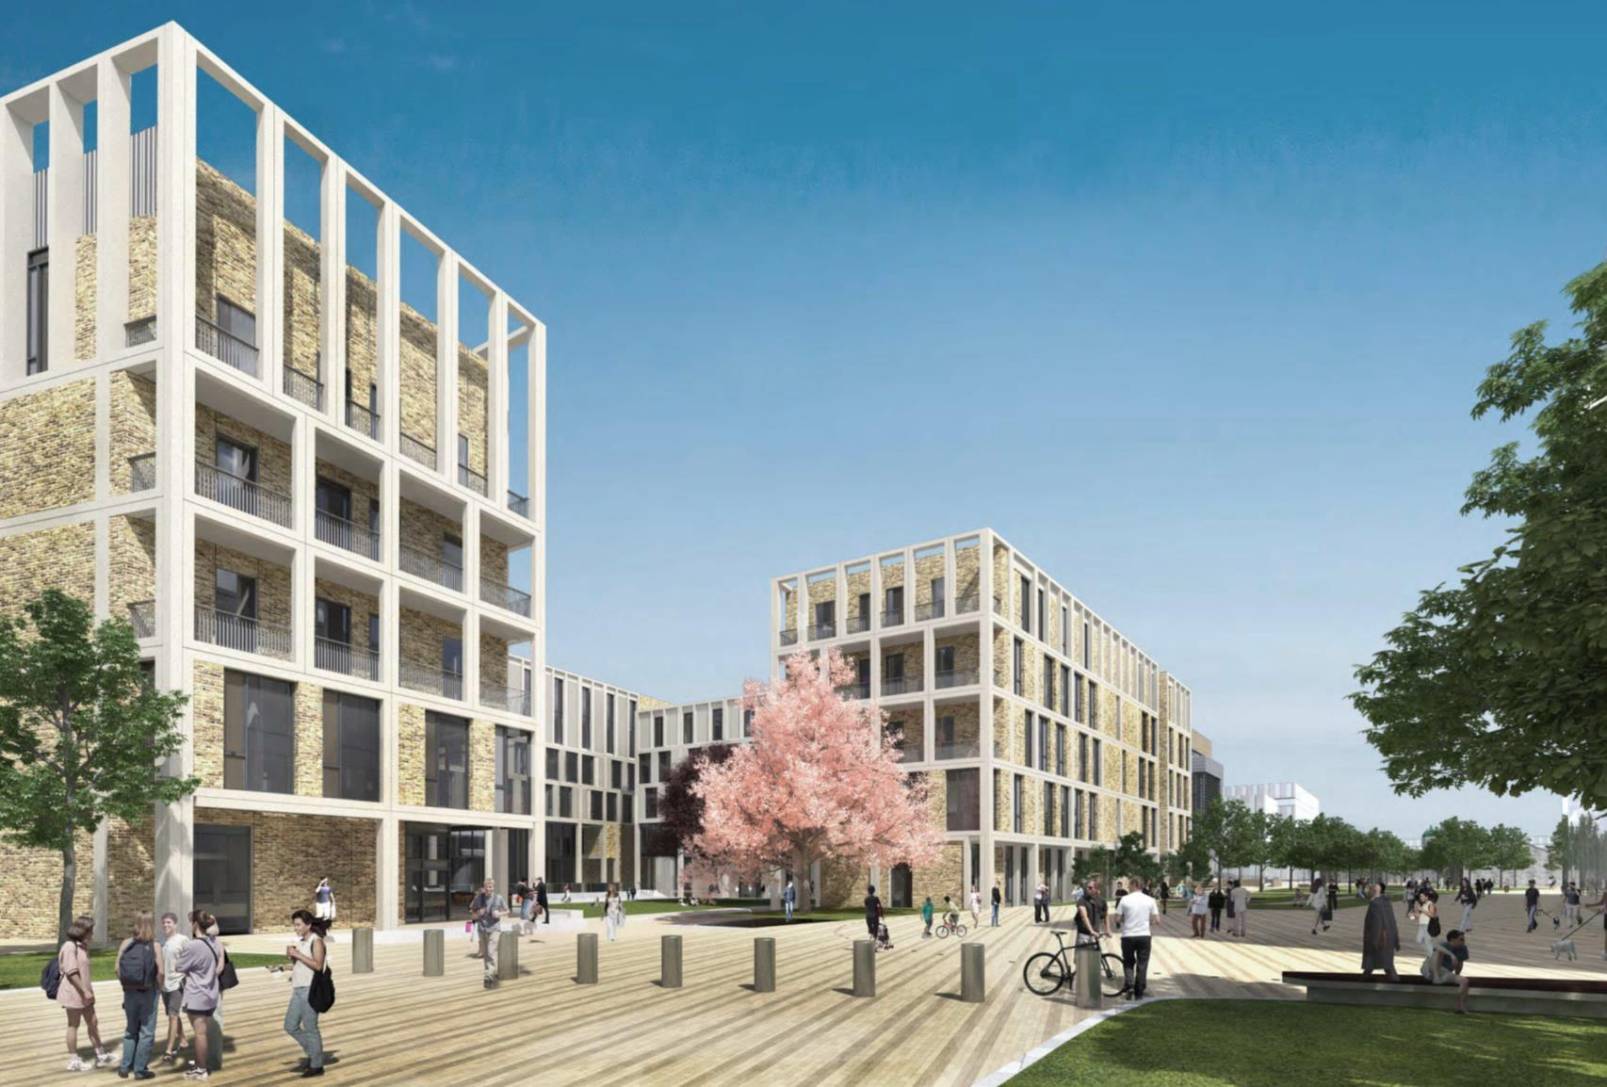
Central and East Quads
November is still the target for start onsite
Sisk onsite for two days at the moment carrying out site testing
Further activity onsite prior to construction start to put Environmental monitoring in place.
East Quad
Central Quad

Slide 6
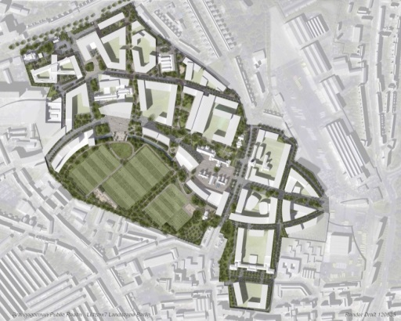
DIT Programme 3 Progress
Academic Hub
Planning anticipated target date mid- October 2017
Energy Centre
Just submitted

Slide 7


Primary School D7ETNS

Slide 8

Labour and Learning Forum

Slide 9
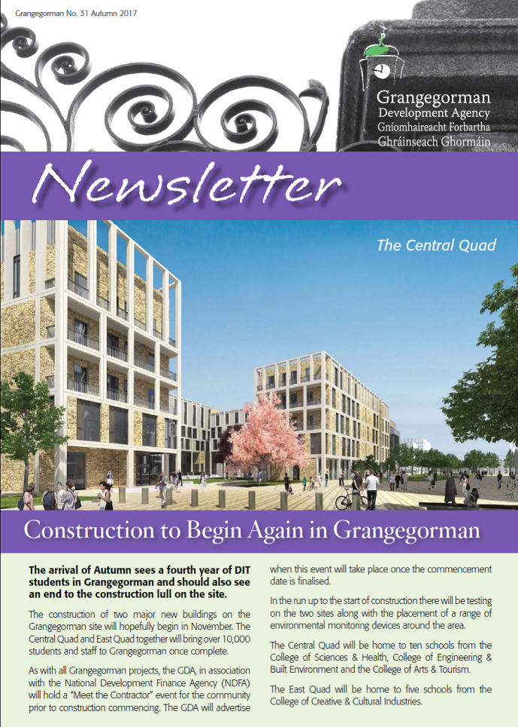
COMMUNICATIONS/COMMUNITY
Ongoing Communications
Communications Review complete. Draft report with GDA for review
Autumn Newsletter published online. Hard copy delivery to begin at the end of the week
GDA Public Art page on Website updated to include information on all projects

Slide 10
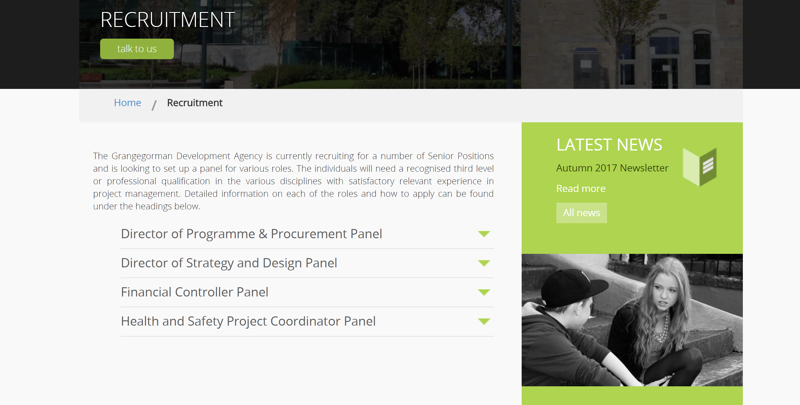
Recruitment
Full Details can be found at http://ggda.ie/recruitment

Slide 11
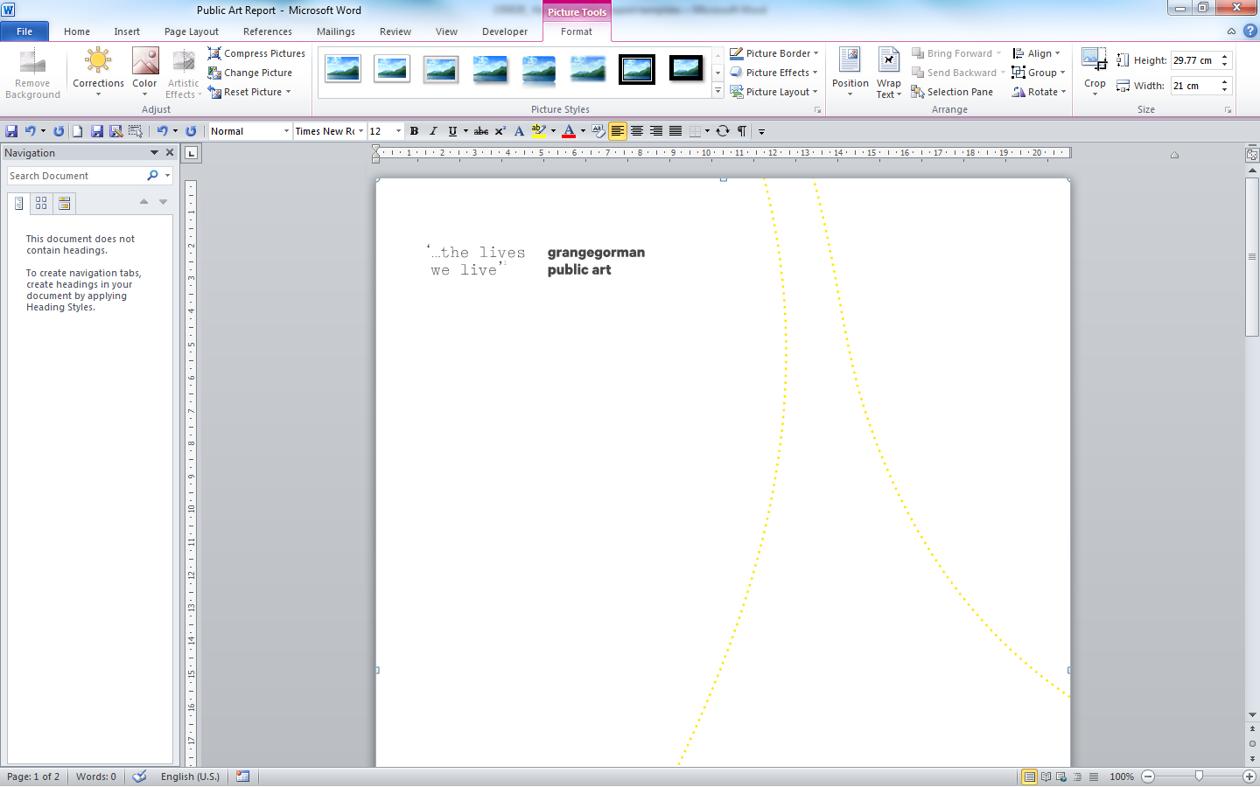
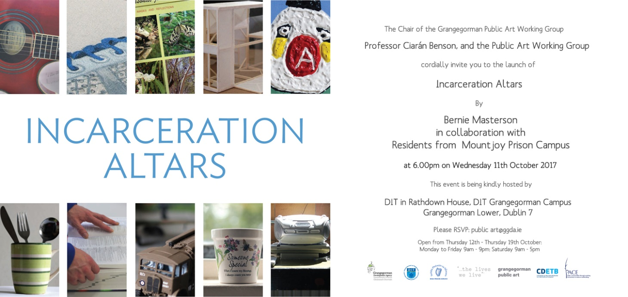
Dates for your Diary
Public Art Evening - 18th October 7.00 – 9.00pm, St. Laurence’s Church

Slide 12
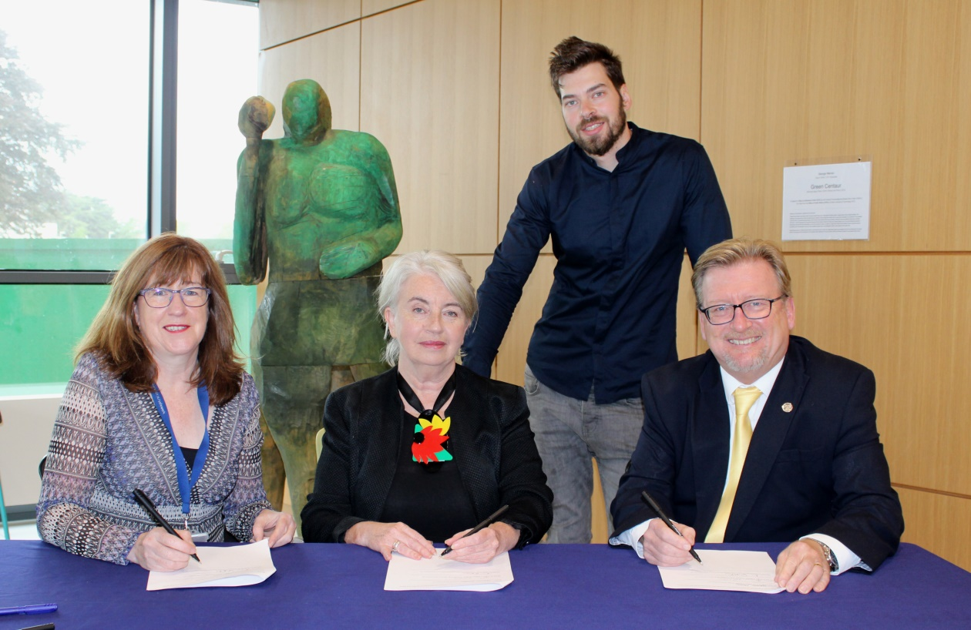
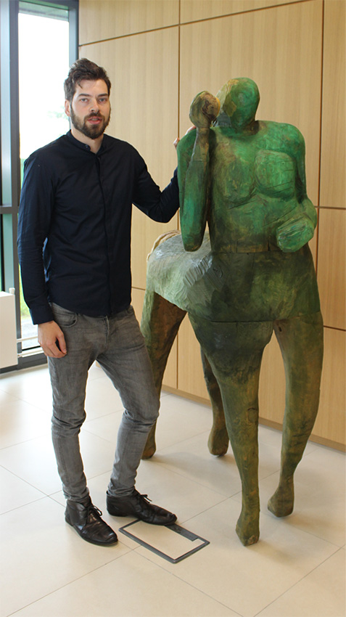
Green Centaur on loan to DIT from OPW

Slide 13
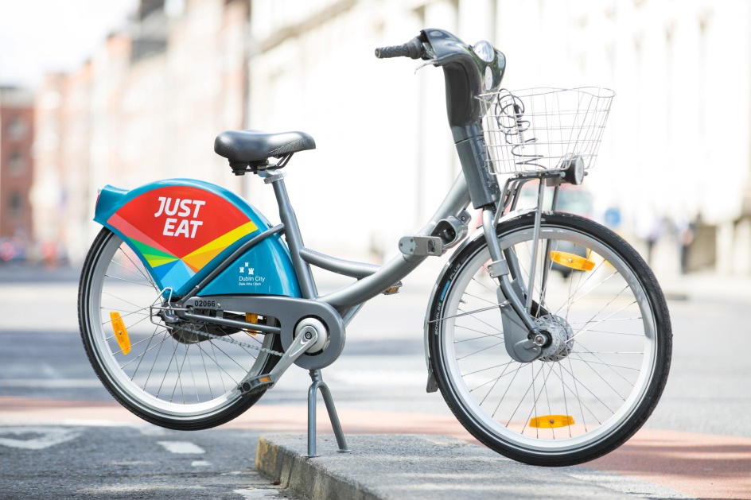
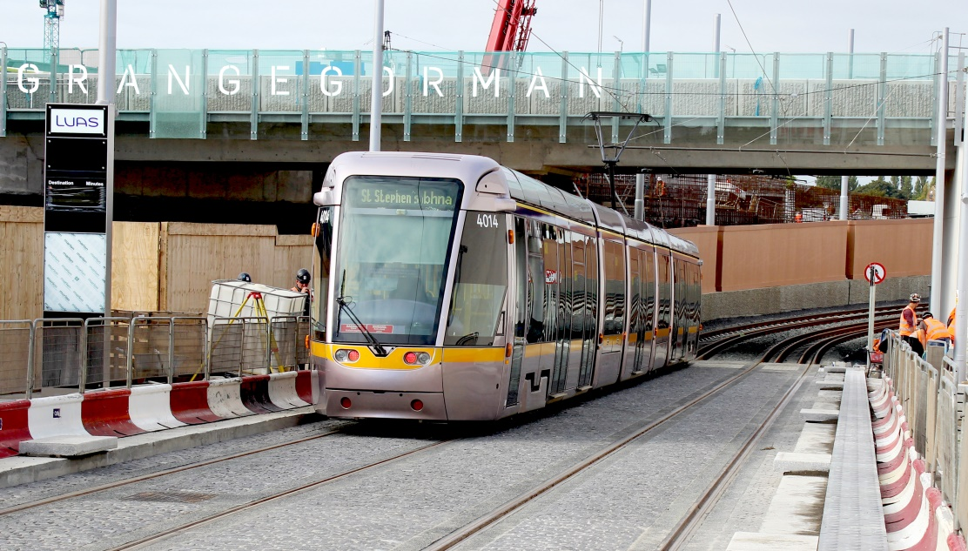
Other Projects

Slide 14

THANK YOU

